Slide 1
Predicting Viral News
Gregory D. Hunkins
Computer Science M.S. Candidate

Slide 2

Task & Approach

Slide 3
Task & Approach
Dataset: Online News Popularity
1
61 Meta-Data Attributes
2 Non-predictive features
Target Feature: Shares
Binary Classification Task: Viral or Not Viral
2
Viral threshold: 1400 shares
Goal: Investigate Pros and Cons of Various Models
3

Slide 4
Task & Approach
Linear Regression
Logistic Regression
Decision Tree
Support Vector Machine
Neural Network
Random Forest
Bagging Classifier

Slide 5
Task & Approach
Grid Search & Cross-Validation
Loading
Cleaning
Scaling
Feature Reduction
Model
Prediction
Binarize
Grid Search

Slide 6
Technologies

Slide 7
Models

Slide 8
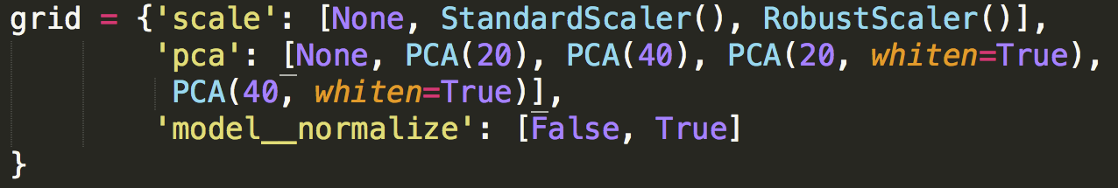
Linear Regression
Grid
Best Model: ['normalize': True, 'pca': None, 'scale': None]
Top 3 Statistics
Model | Mean Test Score | Mean Train Score | Mean Fit Time | Mean Score Time
1 | 0.56321259 | 0.56630246 | 0.25954803 | 0.11623399
2 | 0.56318737 | 0.56640336 | 0.49031925 | 0.12336079
3 | 0.56308647 | 0.56593672 | 0.63596638 | 0.10120964

Slide 9
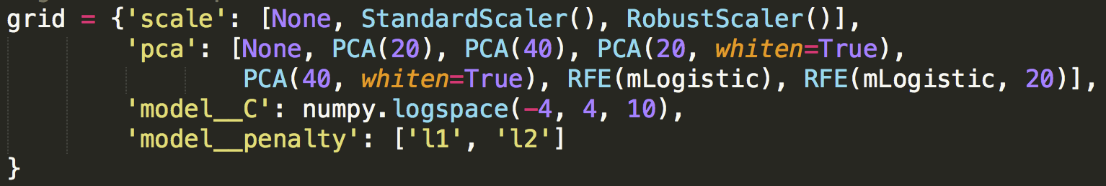
Logistic Regression
Grid
Best Model: [C': 0.0464, 'penalty': 'l1', 'pca': RFE(mLogistic), 'scale': StandardScaler]
Top 3 Statistics
Model | Mean Test Score | Mean Train Score | Mean Fit Time | Mean Score Time
1 | 0.64418323 | 0.65361749 | 3.15672898 | 0.00997774
2 | 0.64403188 | 0.65234366 | 4.54408201 | 0.00966096
3 | 0.64385531 | 0.65473997 | 3.20440666 | 0.00934633

Slide 10
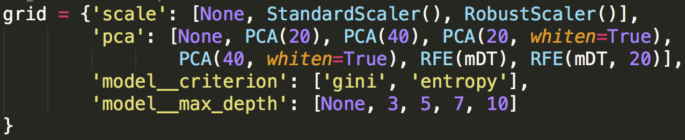
Decision Tree
Grid
Best Model: [{'pca': None, 'criterion': 'entropy', ‘max_depth': 5, 'scale': StandardScaler()]
Top 3 Statistics
Model | Mean Test Score | Mean Train Score | Mean Fit Time | Mean Score Time
1 | 0.626854 | 0.64979604 | 0.82398709 | 0.01654363
2 | 0.626854 | 0.64979604 | 0.82643302 | 0.01265494
3 | 0.62677833 | 0.64978343 | 0.77525695 | 0.00961701

Slide 11
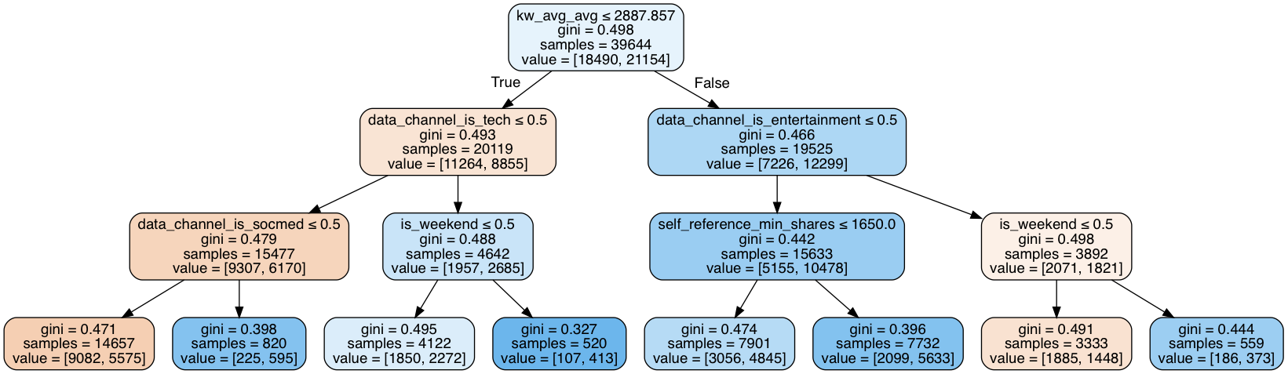
Decision Tree

Slide 12
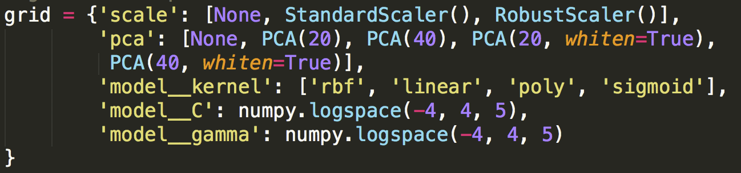
SVM
Grid
Best Model: ['pca': None, 'scale': StandardScaler(), ‘kernel’: ‘rbf’, ‘C’: 1, ‘gamma’: 1]
Top 3 Statistics
Model | Mean Test Score | Mean Train Score | Mean Fit Time | Mean Score Time
1 | 0.64299768 | 0.71061198 | 106.519186 | 26.2136486
2 | 0.6380789 | 0.72089104 | 89.4379713 | 21.1000621
3 | 0.63656543 | 0.73514273 | 140.421023 | 27.5419523

Slide 13
Neural Network
One Hidden Layers: 69.60% accuracy
Two Hidden Layers: 70.50% accuracy

Slide 14
Random Forest

Slide 15
Bagging Classifier

Slide 16
Conclusion

Slide 17
Questions?

